Slide 1


Customer Data Analysis
Capstone Project
Team ID: PTID-CDA-NOV-25-884
Project ID: PRDA-05
Name: Sainanthan
Thirumurugan
Email ID: sainanthan2003@gmail.com
thirumurugan.j143@gmail.com

Slide 2
Customer Data Analysis
Project Overview
This project analyzes real customer shopping transactions across multiple malls using SQL for data exploration and Power BI for interactive visualizations. The goal is to understand customer behavior, identify revenue drivers, and provide insights that help businesses optimize marketing, inventory, and customer engagement strategies.
Key Focus Areas :
➤ Gender-based buying patterns.
➤ Age-wise customer performance.
➤ Category-level revenue and sales insights.
➤ Payment method usage and preferences.
➤ Monthly revenue trends and seasonality.

Slide 3



Customer Data Analysis
Tools Used :
1. SQL: Data exploration, querying, aggregations
2. Power BI: Dashboard design, visuals, KPI tracking
3. Power Query: Data cleaning & transformation
4. DAX: Measures for dynamic analysis
5. Excel/CSV: Exporting data from SQL

Slide 4
Customer Data Analysis
Data Preparation Workflow
Data Connection
SQL Data Exploration
SQL Analysis (10 Tasks)
Export to Excel/CSV
Load into Power BI
Dashboard & Insights

Slide 5
Customer Data Analysis
Business Problem Analyzed
Task:
1.How is the shopping distribution according to gender?
2.Which gender did we sell more products to?
3.Which gender generated more revenue?
4.Distribution of purchase categories relative to other columns?
5.How is the shopping distribution according to age?
6.Which age cat did we sell more products to?
7.Which age cat generated more revenue?
8.Distribution of purchase categories relative to other columns?
9.Does the payment method have a relation with other columns?
10.How is the distribution of the payment method?

Slide 6


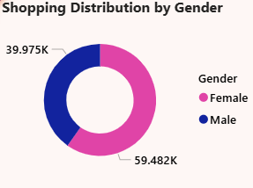

Customer Data Analysis
Problem:
How is the shopping distribution according to gender?
One gender dominates shopping activity, showing stronger engagement and higher store interaction.

Slide 7

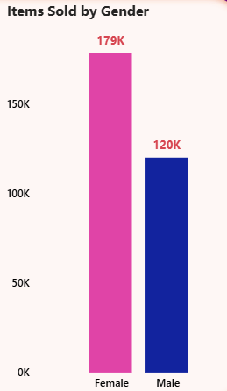
Customer Data Analysis
Problem:
Which gender did we sell more products to?
Higher product quantity is driven by one gender, indicating stronger purchase frequency.

Slide 8


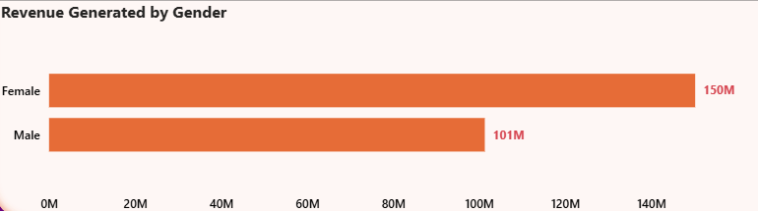
Customer Data Analysis
Problem:
Which gender generated more revenue?
Revenue contribution is higher for one gender, revealing a more valuable customer segment.

Slide 9
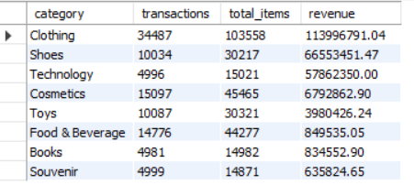
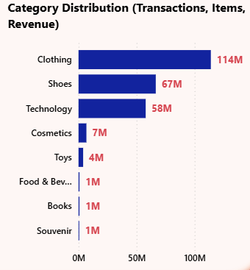
Customer Data Analysis
Problem:
Distribution of purchase categories relative to other columns?
Top categories consistently outperform others across transaction, items, and revenue.

Slide 10
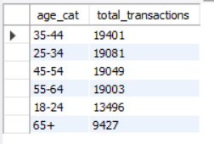
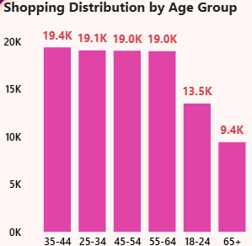
Customer Data Analysis
Problem:
How is the shopping distribution according to age?
Specific age groups show the highest shopping participation, shaping key customer demographics.

Slide 11
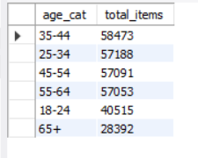
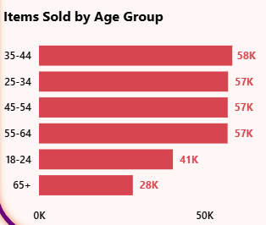
Customer Data Analysis
Problem:
Which age cat did we sell more products to?
One age group category purchases the most items, highlighting strong buying intensity.

Slide 12
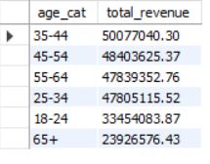
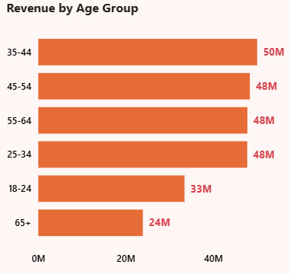
Customer Data Analysis
Problem:
Which age cat generated more revenue?
Revenue is largely driven by a core age group, making them the key sales segment.

Slide 13
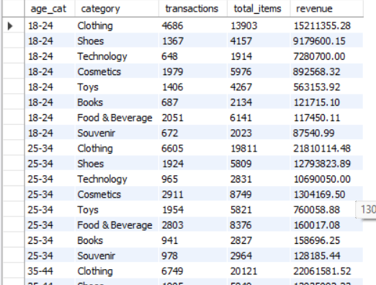

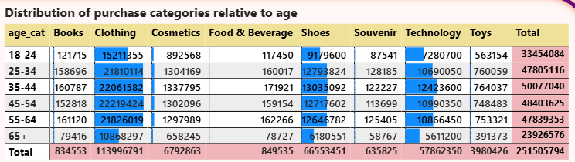
Customer Data Analysis
Problem:
Distribution of purchase categories relative to other columns?
Product category preferences vary across age and transactions, enabling targeted product positioning.

Slide 14
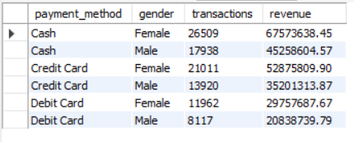
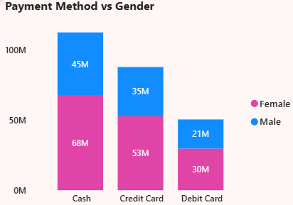
Customer Data Analysis
Problem:
Does the payment method have a relation with other columns?
Payment choices differ by age, gender, and category, reflecting diverse customer preferences.

Slide 15
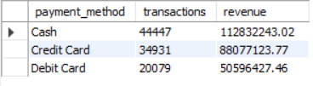

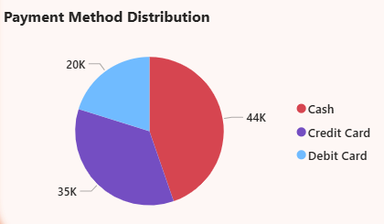
Customer Data Analysis
Problem:
How is the distribution of the payment method?
A cash payment method dominate transactions, confirming strong customer preference trends.

Slide 16

Customer Data Analysis
Key Insights Summary
The analysis highlights clear behavioral patterns across customer segments, product categories, and payment preferences:
💠 Female gender contributes more revenue, making it the primary high-value customer segment.
💠 Age 25–34 and 35–44 show the highest buying activity and spending levels.
💠 Top-performing categories generate a major share of total sales, driving overall business growth.
💠 Cash & Cards are the most preferred modes across customers.

Slide 17

Customer Data Analysis
Business Recommendations
Based on data-driven insights from customer trends and revenue patterns, the following strategic actions are recommended:
1. Target High-Performing Age Groups:
Focus marketing and loyalty programs on the strong 25–34 and 35–44 customer segments.
2. Optimize Inventory for Top Categories:
Prioritize stock and promotions for high-demand categories, especially during peak months.
3. Strengthen Female-Focused Campaigns:
Introduce targeted offers and product bundles for female shoppers if they drive higher revenue.
4. Encourage Digital Payments:
Boost UPI & card usage with cash back, discounts, and reward-based incentives.
5. Deliver Personalized Product Recommendations:
Use age and gender insights to provide customized category suggestions and increase basket value.

Slide 18
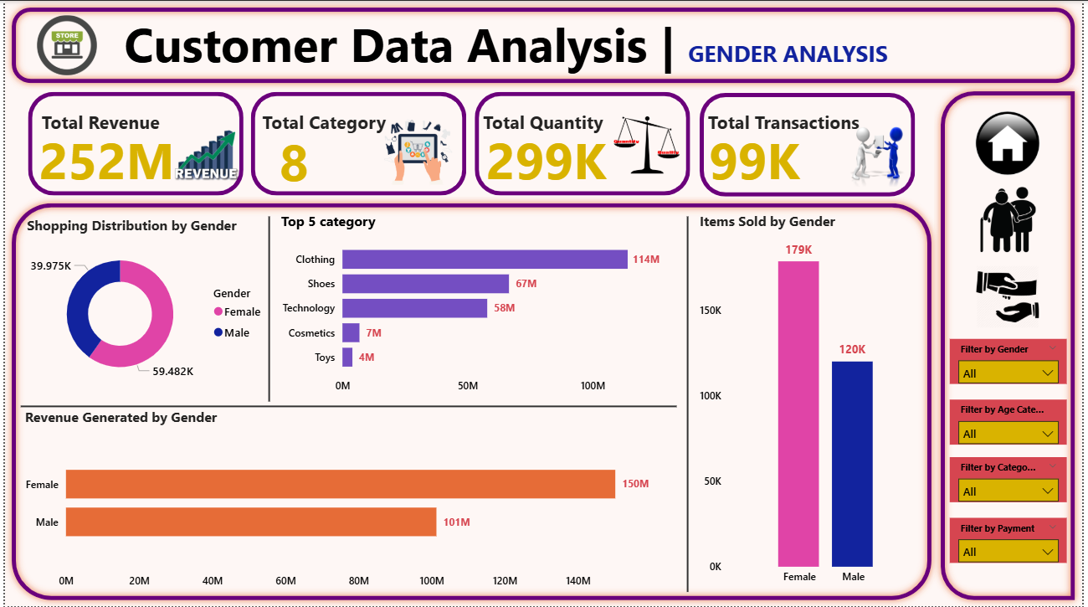
Customer Data Analysis
Dashboard

Slide 19
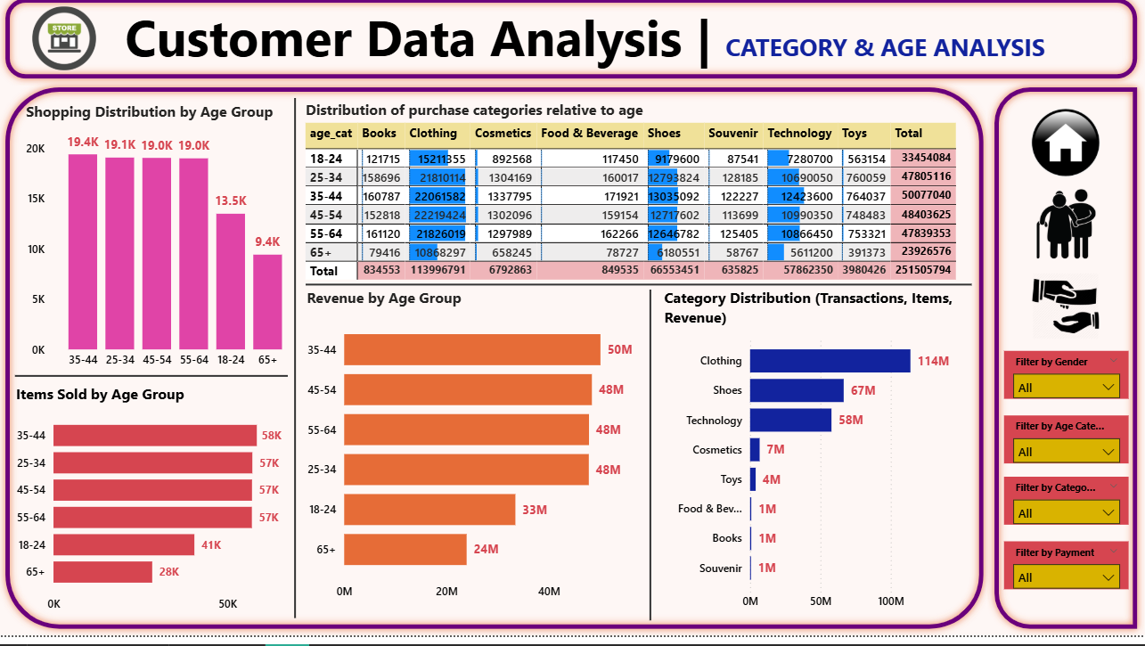
Customer Data Analysis
Dashboard

Slide 20
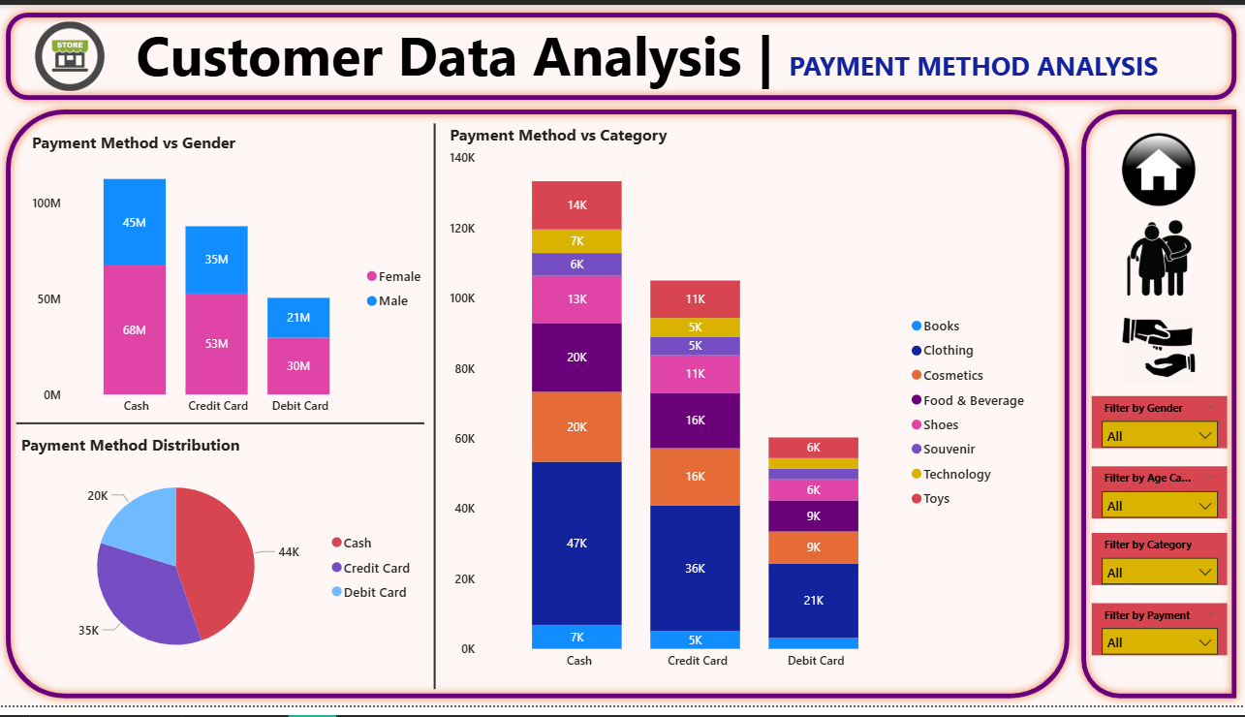
Customer Data Analysis
Dashboard

Slide 21

Customer Data Analysis

